Slide 1
City Manager’s Update December 12, 2018

Slide 2
City Manager’s Update
City Council Goals
Council Top and High Priorities
Council Action Report
Petitions List

Slide 4
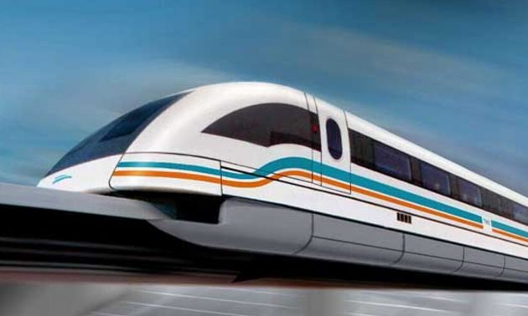
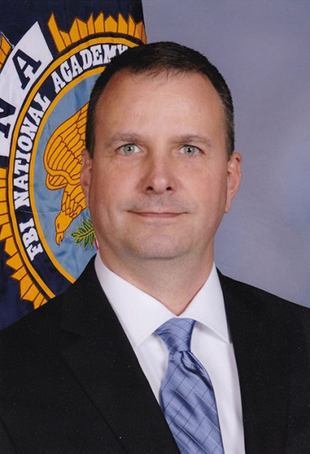
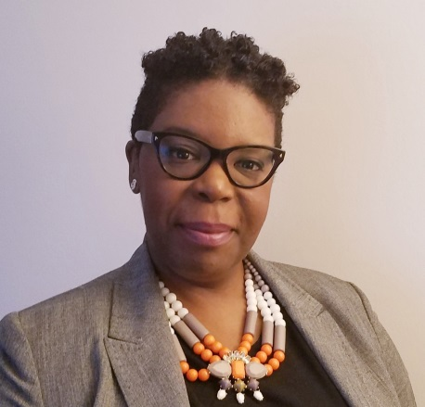

Slide 5
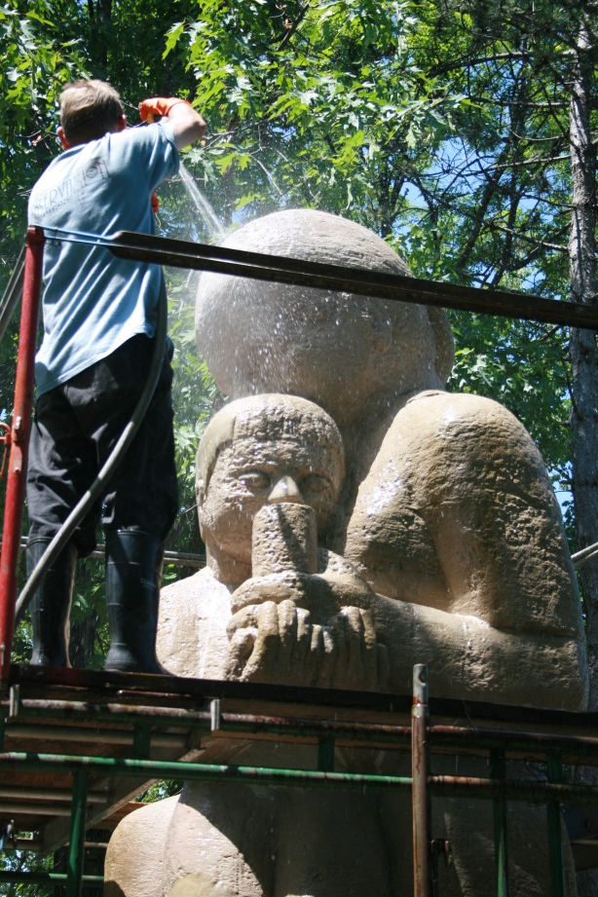
FY2019 Accomplishments to date July to December 2018
Completed road resurfacing: Ora Glen & Ridge Road
Removed dilapidated bus stops/constructed ADA compliant bus stops-Hanover Pkwy, Springhill Ln
Reinvested in Council Chambers
Earned grants to preserve & restore historic artwork and facilities

Slide 6
FY2019 Accomplishments to date July to December 2018
Celebrated Greenbelt’s 80th Anniversary
Performances, Juried Arts & Craft Show, Art Exhibitions and Artful Afternoons and Art Drop-Ins
Festivals and Special Events-Holiday Lights- Festival of Lights, Greenbelt East Lights (Greenbrier), Family Fun Nights, Trunk or Treats, Halloween Costume Parade, Fall Fest, Pumpkin Walks, & Labor Day
Runs, Walks & Rides-Gobble Wobble to WABA Rides

Slide 7
FY2019 Accomplishments to date July to December 2018
Hired new Police Officers & Communications Specialists
Re-establishing the Bike Patrol and Explorers
Interacting with neighbors at multiple National Night Out events, Fall Fest, Trunk or Treats, Halloween Costume Parade, HOAs, DARE, Bike Patrol, Business Coffee, Rotary Club, & Youth Forum

Slide 8
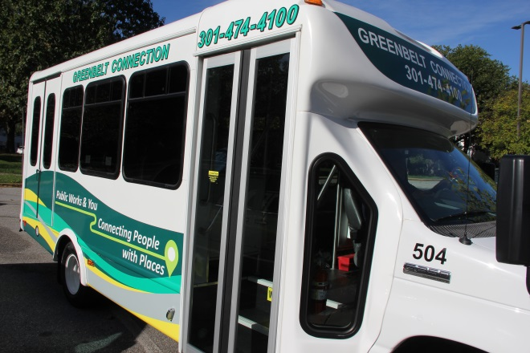
FY2019 Accomplishments to date July to December 2018
Completed Forest Preserve Study
Finalizing the Tree Master Plan
Earned Tree City USA
Re-certified Sustainable Maryland
Launched New Greenbelt Connection Bus

Slide 9
FY2019 Accomplishments to date July to December 2018
Updated and replaced various servers, equipment and software
Implementing a Document Management System – Pilot in Human Resources
Implemented a Website Content Management System - New Website
Implementing a New Electronic Agenda Preparation System
Implemented a Council Chambers Audio/Visual Equipment Upgrade

Slide 10
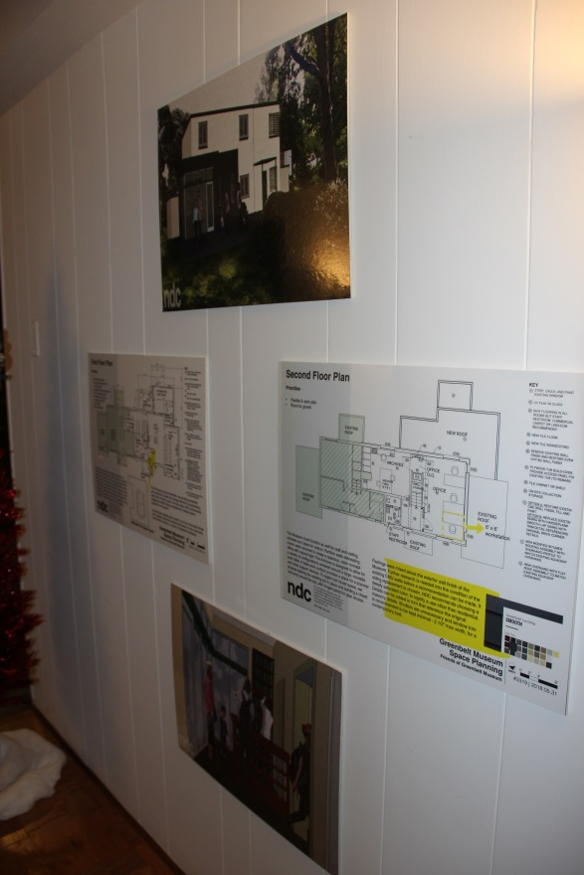
FY2019 Accomplishments to date July to December 2018
Updating an agreement with Friends of the Old Greenbelt Theater
Marketing the Commercial Kitchen to support businesses
Supported Greenbelt News Review by identifying space for Archival Project
Continue to support transformation of 10-A Crescent into a museum visitor center

Slide 11
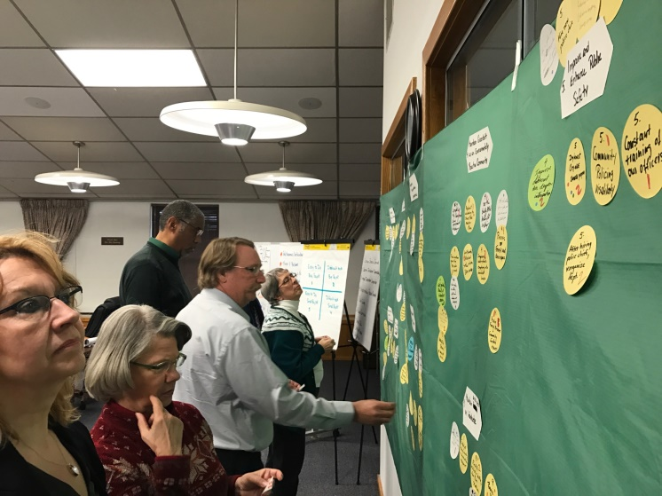
Action- Top & High Priorities

Slide 12
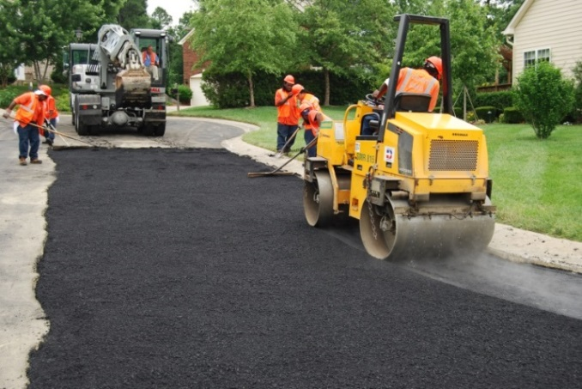
Maintain & Invest in Infrastructure
Constructed FY19 road resurfacing & sidewalk repair (Ora Glen Drive, Ridge Road) as well as interim repair on Cherrywood Lane
Installed raised crosswalk and signage on Ridge Road
Opened new Community Center Playground
Operating new solar energy system at Springhill Lake Recreation Center
Repaired roof and HVAC at Greenbelt Aquatic & Fitness Center

Slide 13
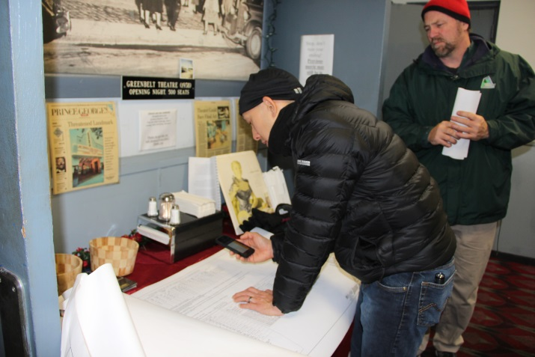
Maintain & Invest in Infrastructure
Continue research on potential Fire Station locations
Completing design & engineering for Theatre HVAC; Estimated January 2019 RFP for Phase II Theatre Renovation
Working toward coordinated financing, permit approvals and RFP for possible June 2019 Lake construction

Slide 14
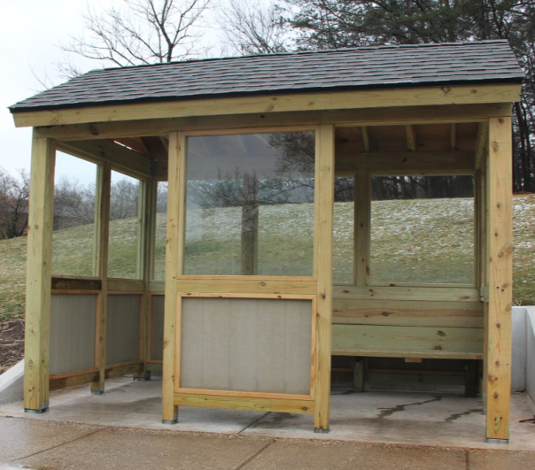
Improve Transportation Opportunities
Continued progress on WMATA Trail design & agreement
Pepco easements
Sessions with Council, Community, WMATA & Developers
Continued implementing Bus Stop Safety and Accessibility Study recommendations
Continued work on bike share feasibility study – County Phase I

Slide 15
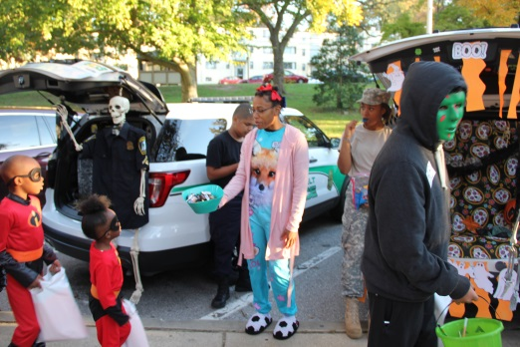
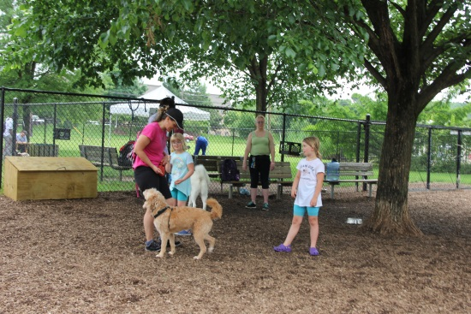
Enhance Sense of Community
Supported expansion of Pumpkin Walk and Fall Fest, Trunk or Treats, & GEAC’s Holiday Tree Lighting
Conditional approval of Central Park
Developing Dog Park recommendations & identifying funding
Issued RFP for Cherrywood Lane Green & Complete Street Study- 5 Responses
Issued RFP for Hanover Parkway Bikeway Study- 9 Responses
Permitting underway; Will let construction RFP for 2019 installation of new “Welcome to Greenbelt” signage

Slide 16
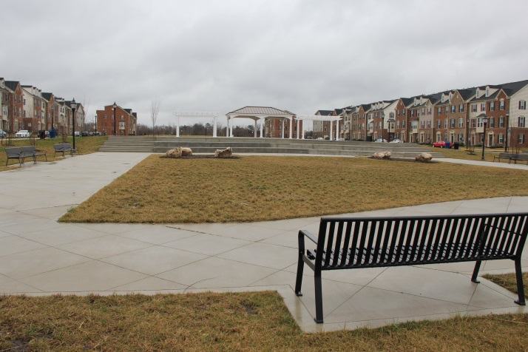
Economic Development & Sustainability
Supported sessions on policy & performance measures-February 2019 visioning sessions
Hired the City’s first economic development coordinator
Continued to implement recommendations
Held Council education sessions on TIF options and status, WMATA Trail Status
TIF implementation underway- bank solicitation issued, market study and related work underway

Slide 17
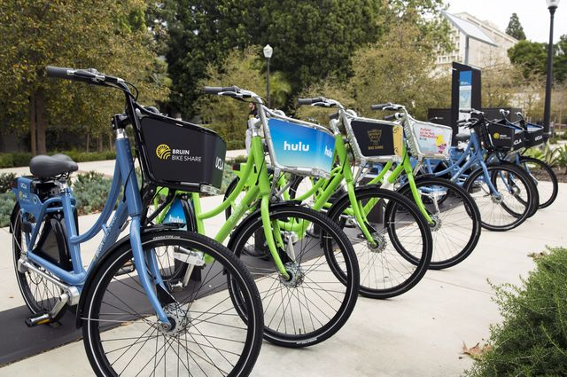
Improve Transportation Opportunities
Progressed in WMATA Trail design & agreement
Awaiting needed Pepco easements
Awaiting MNCPP meeting & review
Held September 2018 Council Work Session
Continued to implement Bus Stop Safety & Accessibility study recommendations
Continued work on bike share feasibility study

Slide 18
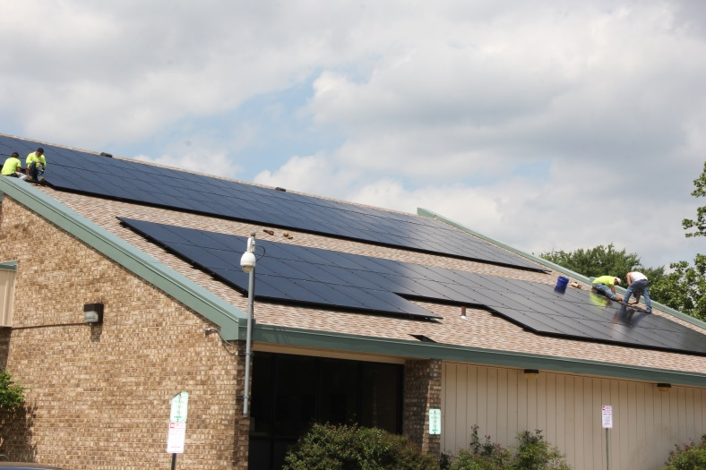
Be Environmentally Proactive
Completing WMATA Trail Design
Under MNPP review
Awaiting Pepco easement
Seeking additional partnership-WMATA, Federal, State, County
Continue MEA Improvements
Training on new solar panel system at Springhill Lake Recreation Center
Purchased electric cars for parking & code enforcement
Pursuing additional electric charging stations

Slide 19
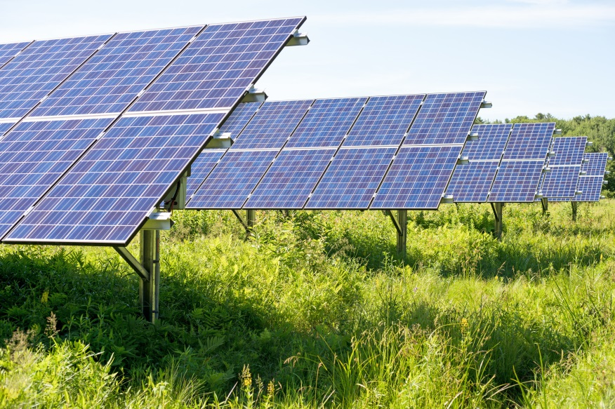
Be Environmentally Proactive
Implementing Solar Farm Agreement to offset City electricity use & costs
Implementing the Tree Master Plan
Continue to seek finalization of Draft Sustainable Land Care Policy by Advisory Boards (Requested Fall 2018)

Slide 20
Improve Public Safety
Swore in new police chief
Continue to Implement City-wide Camera Program repairs/replacements: Spellman Pedestrian Overpass, Youth Center, & Community Center
Reviewing engineer’s draft scope for study of Lakecrest Drive/Lakecrest Circle/Legion Drive Improvements (December 2018)
Identify funding and contractor
Work to gain State approval

Slide 21
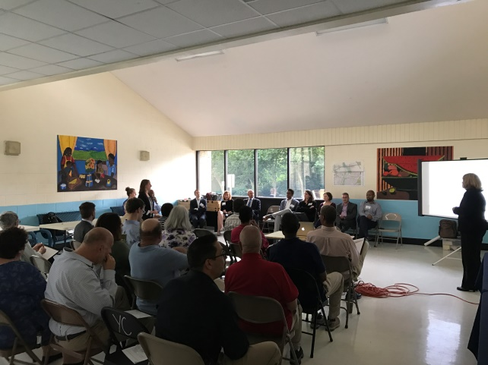
Preserve & Enhance Legacy as a Planned Community
Continue to monitor County Zoning Ordinance Rewrite & Legacy Zone request (Fall 2018)
Continue cooperative planning & advocacy for MD193/Greenbelt Road Study Improvements

Slide 22
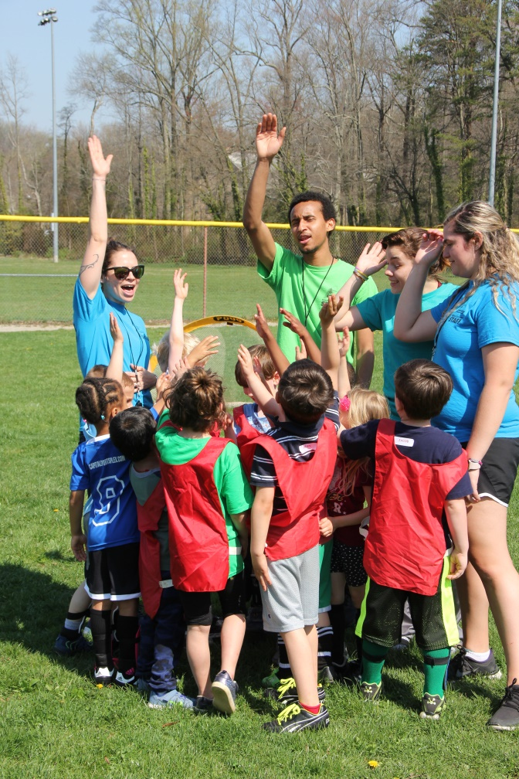
Promote Quality of Life for All Residents
Held education sessions with Census 2020 officials, other agencies
Developing Census Complete Count Committee recommendations & Outreach Plan (Draft presented in August 2018)

Slide 23
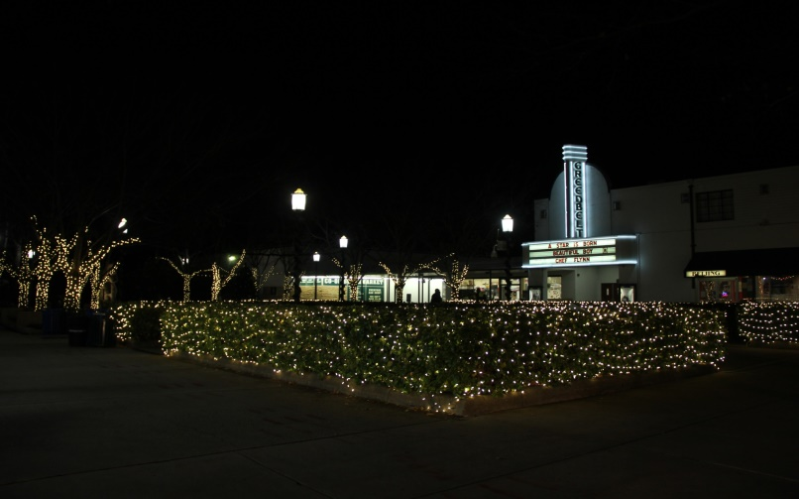
Provide Excellent Constituent Service
Continuing to advocate against the Maglev
December 13, 2018 meeting- Baltimore
Transitioning Animal Shelter Management to Police
Reporting to Police; Shelter Manager recruitment underway
Providing financial & cleaning support to the Old Greenbelt Theatre (Monthly financial, cleaning)
Finalize Friends of the Old Greenbelt Theatre lease agreement (December 31, 2018)

Slide 24
Provide Excellent Constituent Service
Expand Public Information Department
Recruitment for Assistant (Fall 2018)
Hired a PT employee, bringing total to 1FT and 3PT
PIO wants 2 PT staff instead of filling the second FT employee
Completed new website design, new content management implementation
Transitioned from paper production of agendas to electronic agenda preparation software
Resolving complaints re: Comcast & Verizon Franchises
Completing App with local company
Received approval from Apple

