Slide 1
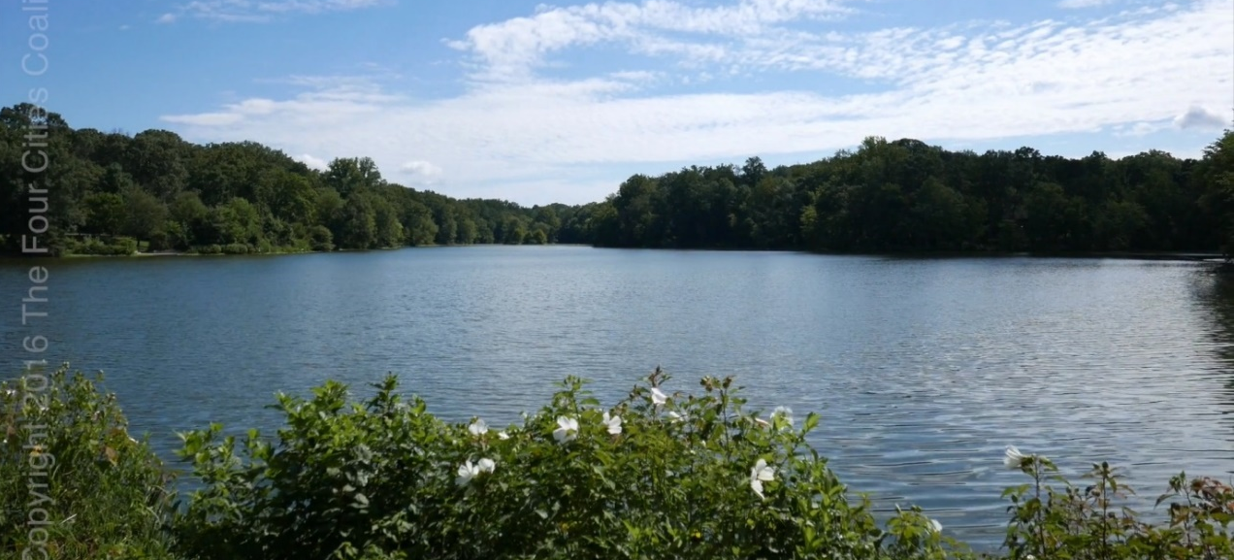
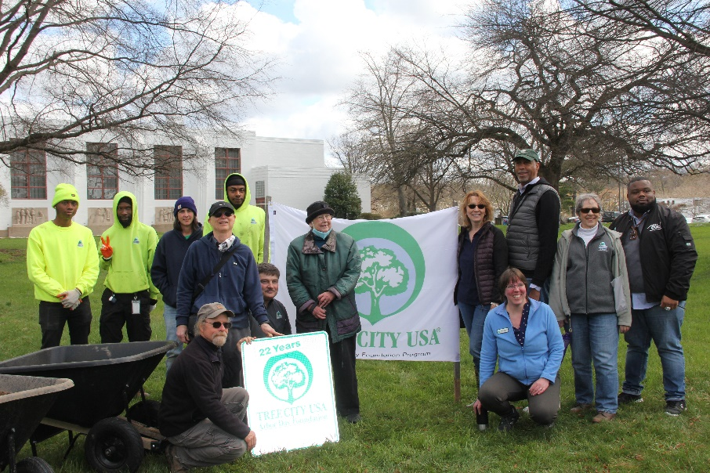
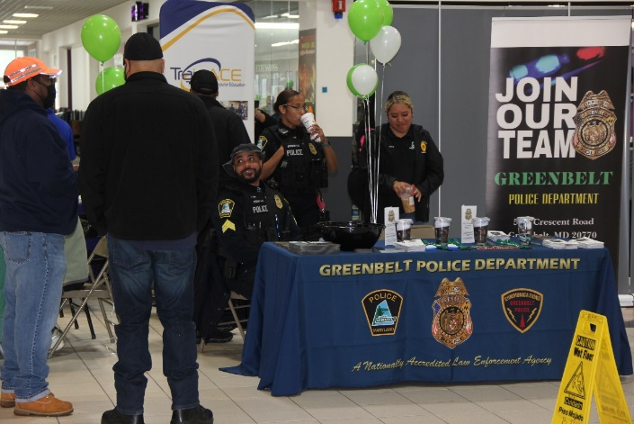
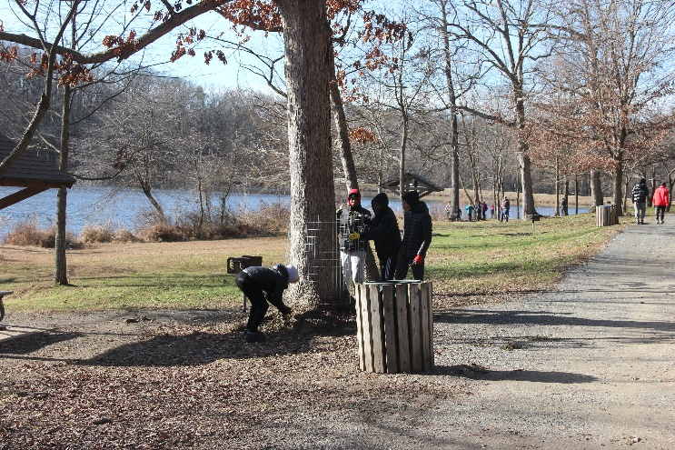
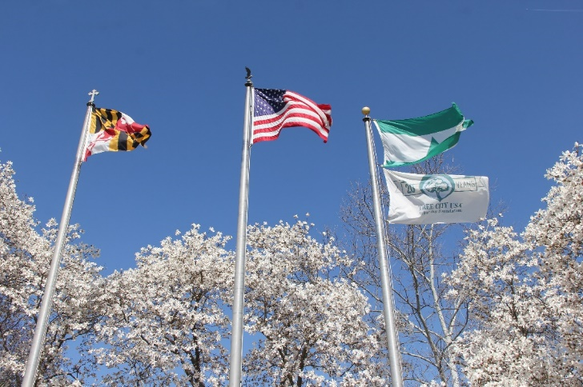
Proposed FY 2024 Budget
Insert Budget Cover

Slide 2
Proposed FY2024 Budget Agenda
Financial and Operational Plan July 1, 2023-June 30, 2024
City Council Goals
FY23 Accomplishments
FY24 Budget Highlights
Budget Focus Areas
Issues and Opportunities

Slide 3
Council Outcome Areas
The City of Greenbelt will provide excellent services, preserve and enhance our legacy, and ensure equity and inclusion in the City by:
Enhancing Our Sense of Community
Improving and Enhancing Public Safety
Ensuring Sustainable Economic Development
Promoting Quality of Life, Health and Wellbeing for all Residents
Improving Transportation Opportunities
Maintaining and Investing in Infrastructure
Maintaining Greenbelt as an Environmentally Proactive Community
Supporting Equity and Inclusion within Greenbelt

Slide 4
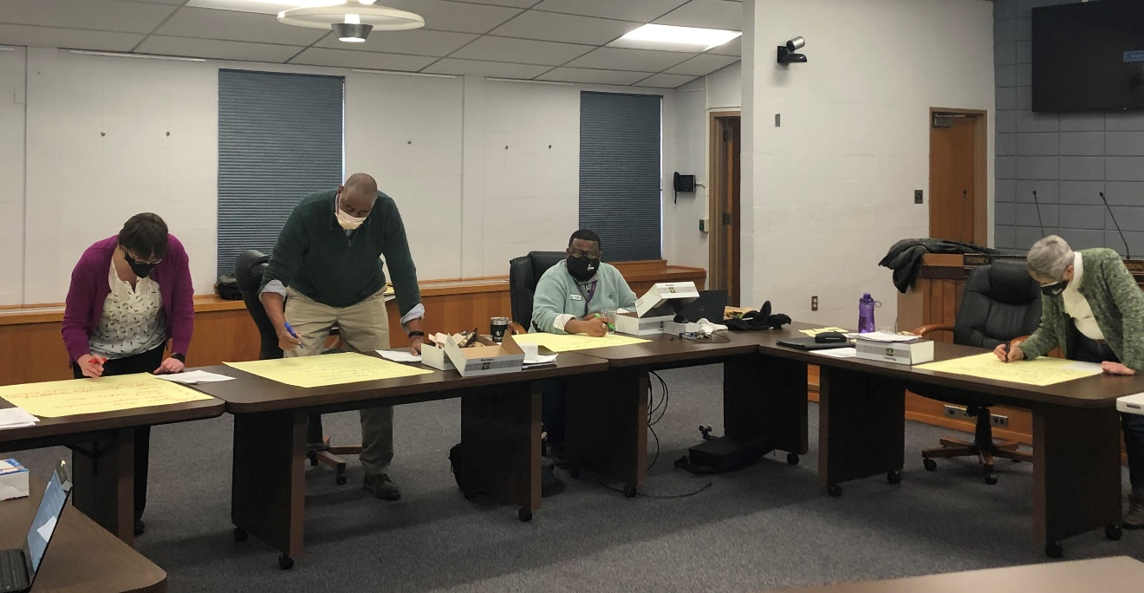
Council Goals: 2022
Promote staff morale and support
Focus on equity and inclusion
Increase tree canopy by adding to the Forest Preserve

Slide 5
FY 2023 Accomplishments
GPD At full 53 Sworn staff & all civilian positions filled
Hired three communications officers (dispatchers)
Hosted Shop with a Cop at Target
Put new electric bikes into service
Completed yearly CALEA file review
Expansion of the Crisis Intervention Team (CIT) program
Completed the Police Station roof rehabilitation project
Greenbelt Connection - Provided 1,512 rides for our Greenbelt residents
Performed major rehabilitation to critical equipment: trucks, loader and Street Sweeper
Removed truckloads of tree debris from Buddy Attick and throughout the City that had fallen during the July 12th storm
Installed a solar panel flashing stop sign on Lastner Ln.

Slide 6
FY 2023 Accomplishments
Received notification from GFOA of the City receiving the Distinguished Budget award.
Completed Phase One of implementing the new financial management system. Phase Two is targeted for completion in mid-March.
Submitted the Quarterly ARPA Reports to Treasury
Completed the 2022 annual audit and ACFR and is now on City’s website.
Submitted the application and supporting material to GFOA for the FY2022 ACFR award. Awaiting decision.
Developed grant program and guidelines for the ARPA-funded Business Improvement Recovery Fund Round III
Re-launched Greenbelt Business Conference for business networking and sharing technical expertise.
Participating in the National League of Cities (NLC) City Inclusive Entrepreneurship Program.
Relaunched a BRE program, and conducted thirty-five (35) business engagement meetings to assess business needs, build networks, and share resources

Slide 7
FY 2023 Accomplishments
Significant increases in use across all media: Facebook, Twitter, Instagram, Web, E-blasts and LinkedIn
PIO Coordinator accepted into the Maryland Equity and Inclusion Leadership Program
Completed the City of Greenbelt Communications Standards guide
Redesigned an interactive ARPA “dashboard” website for project tracking
Cameras installed and operational at Municipal Building and SHL Rec
Door security project underway at GAFC, CC Doorbell system
Alarm and Fire Alarm upgrades are in process at all City facilities
Network security assessment completed by CyberCX
New departmental printers deployed to eliminate a security vulnerability
Requested pricing quotes and prepared RFP’s for various ARPA projects

Slide 8
FY 2023 Accomplishments
The conversion of North and South Center Drives was completed and feedback to date has been positive.
The Final Draft of the 193 Corridor Study was completed and publicized
Solar lighting was installed on three bus shelters and feedback has been positive
Obtained MHT Permit for lighting improvements on the exterior of the Community Center to address safety concerns
CARES Staff attended “Foundations of Racial Equity: Session II, Walking the Walk” conference
Job Fairs at Beltway Plaza. 75+ people attended ranging in age from 17-71.
GAIL Program hosted the Back-to-School Mini Health Fair at Springhill Lake Recreation Center.
CARES has dispersed $2,056,000 in ARPA Rental and Utility Assistance to 410 households and $64,000 in Mortgage and HOA Assistance to 18 households.
In addition, $131,000 has been dispersed to local food pantries and for City food distribution events.

Slide 9
FY 2023 Accomplishments
The Community Center has completed the 2023 reservation renewal process for paying and free-space groups. There are currently 42 groups being served with another 15-20 anticipated to be returning in the next few months.
GAFC offers Youth swim classes, Aqua Mania (adult water exercise class), and Senior Swim returned in the summer and First-Aid/CPR/AED and lifeguard training courses
The Youth Center has expanded service learning opportunities for students by expanding volunteer opportunities during the school year.
Youth Center gym offerings have expanded beyond basketball to support pickleball and badminton, with additional intergenerational opportunities planned for the fall.
Security improvements at Recreation facilities are ongoing: security cameras at SLHRC; access control systems at CC & GAFC; and the CC’s conversion to the same alarm system used at other City facilities.
Special events returned to in-person attendance: Fall Fest, Halloween Wild Rumpus, Spooky SHLRC event, Gobble Wobble, Tree Lighting, Sparkle Mart, and Santa’s Visit.
Museum held the first holiday open house at the Museum since 2019. Over 75 people attended including many who identified as new residents.
Worked with Grant Coordinator and Interim City Manager to submit a bond initiative request for funds to support the Education and Visitor Center at 10A.
As staff liaison to the Reparations Commission, the Director scheduled the first meeting of the group for February 9.
Director, along with FOGM, completed work with a fundraising consultant resulting in a comprehensive capital campaign plan and fundraising materials for the 10A project.

Slide 10
FY 2023 Accomplishments
Finalized and recommended Classification and Compensation Study
Onboarded 43 new employees
Rolled out the online benefits self-serve service with employee navigator.
Posted an architect RFP for Municipal Building expansion options: interviewing finalists – mid-summer completion
Hired the Diversity, Equity & Inclusion Officer & Grants Coordinator
Customized grant database for Greenbelt’s needs; entered data on 284 grants.
Assisted with drafting specialized “Purchasing Guidelines” governing the use of ARPA funds.
Revised the Economic Development webpages
Submitted and was awarded a USDA Compost and Food Waste Grant with DPW

Slide 11
FY 2023 Accomplishments: ARPA
Expended or launched $10.4M
Actively being pursued $10.2M
Remaining approved projects to pursue $2.2M
Helped 457 residents with $2,384,500 in rental assistance
Helped 19 residents with $68,500 in mortgage/HOA assistance
Distributed $131,000 to local food pantries and 200 holiday food baskets
Launched/approved $3.9M programs for:
College/Tech School Scholarships
First-time Home Buyer Assistance
Healthcare Vouchers
Business Assistance (BIRF 3)
Non-profit Assistance
Tree Canopy Grants
Business Infrastructure Grants (coming soon)
Partnering with:
Maryland DCHD
GHI
CCI, Old Greenbelt Family Health, Luminus-Doctors Hospital
TrainAce (scholarships)
Beltway Plaza
Advisory Boards
Childcare providers

Slide 12
Proposed FY 2024 Budget
Revenues $35,896,600
Expenses $35,818,200
Net $78,400
Revenues up 7.63%
Expenses up 7.33%

Slide 13
FY24 Revenue Highlights
Revenues
Real Estate Taxes $22.5M
Income Tax $3.4M
Capital Reserve Fund (fund transfer) $1.6M
Highway User Revenues $715K
Key Highlights
No tax rate increase
Property values up across the board
Recreation revenues returning to pre-COVID levels

Slide 14
FY24 Expenditure Highlights
Classification & Compensation Study Implementation
EV Infrastructure
Project spending
DEI Baseline Assessment
Charter/Code (& COPAR) Update
Reparation Commission
Greenbelt Station Amenities
EV Infrastructure (DPW & PD)
Return to pre-COVID-19 operations/revenues

Slide 15
Areas of Focus
Improving Efficiency and Staff Support
Implementation of the Classification & Compensation Study
New Finance Software
Safety and Security Improvements
Space Study Implementation: Architect Study
Continued Progress on ARPA Projects
Direct Resident & Business Support
Critical Infrastructure, Capital Improvements and Equipment
Looking to the Future
Supporting the FBI move
Continuing to oppose MAGLEV
Plans, Assessments and Studies
Acquisition of the Armory Property

Slide 16
Staff Compensation/Changes
Classification & Compensation Study Recommendations
Option 2: Market Adjustment - All staff * receive a 2% COLA, all staff below Market are given a raise to market
Option 3: Decompression - All staff* receive an additional increase of 0.5% for each year of service up to 10 years (5.0%).
Merit: As applicable, staff will receive a merit increase of up to 3% (received on their work anniversary date).
Staff Additions/Modifications
Assistant Director for Community Development
Human Resources Specialist
Crisis Intervention Counselors
Community Inspector Position
* Non-sworn staff only.

Slide 17
Replacement Fund
Ford Hybrid SUV Recreation
LiveScan Police
Chevy Bolt EV Planning/Code
2 Ton Dump Truck, Crew Cab Public Works
TOTAL COST $335,000

Slide 18
Continuing FY23 ARPA Funded Projects
Building Capital Reserves
Chiller Replacement (CC)
AHU Unit (MB)
AHU Replacement (SHLRC)
Space Study Recommendations (MB/CC)
Capital Projects
Pedestrian/Bike Master Plan
Bus Stop Accessibility Study
Street Resurfacing
Misc Concrete Repairs
Greenbrook Trails
Buddy Attick Inclusive Playground

Slide 19
On the Horizon: Issues and Opportunities
Issues
Providing adequate space for staff and City programs
Retention and recruitment of staff
Retention, expansion and attraction of businesses
Facility/field improvements
Opportunities
Continued Focus on ARPA Project Implementation
Beltway Plaza Project
Possible FBI Headquarters
Acquisition and development of the Armory property

Slide 20
Thank You!
City Staff
Department Directors
Bertha Gaymon, City Treasurer
Anne Marie Belton, Executive Associate
James Wisniewski, Public Information Specialist
City Council
Greenbelt Residents

