Slide 1
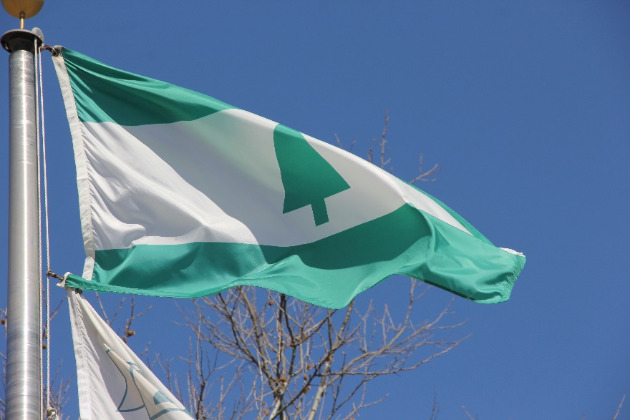
City Manager’s Quarterly Update FY23-Q1 October 26, 2022

Slide 2
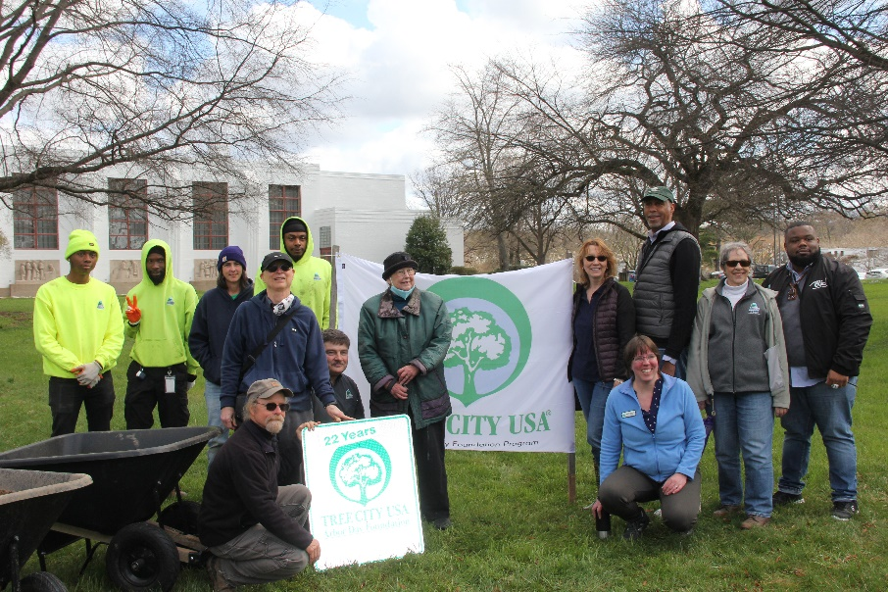
City Manager’s Update: 2023-Q1 Agenda
City Council Outcome Areas 2022
Department Highlights
Personnel: Open Positions
Personnel: Pending and Potential Retirements
Challenges and Opportunities
Questions and Discussion

Slide 3
2022 Outcome Areas
The City of Greenbelt will provide excellent services, preserve and enhance our legacy, and ensure equity and inclusion in the City by:
Enhancing Our Sense of Community
Improving and Enhancing Public Safety
Ensuring Sustainable Economic Development
Promoting Quality of Life, Health and Wellbeing for all Residents
Improving Transportation Opportunities
Maintaining and Investing in Infrastructure
Maintaining Greenbelt as an Environmentally Proactive Community
Supporting Equity and Inclusion within Greenbelt
FACILITATED BY

Slide 4
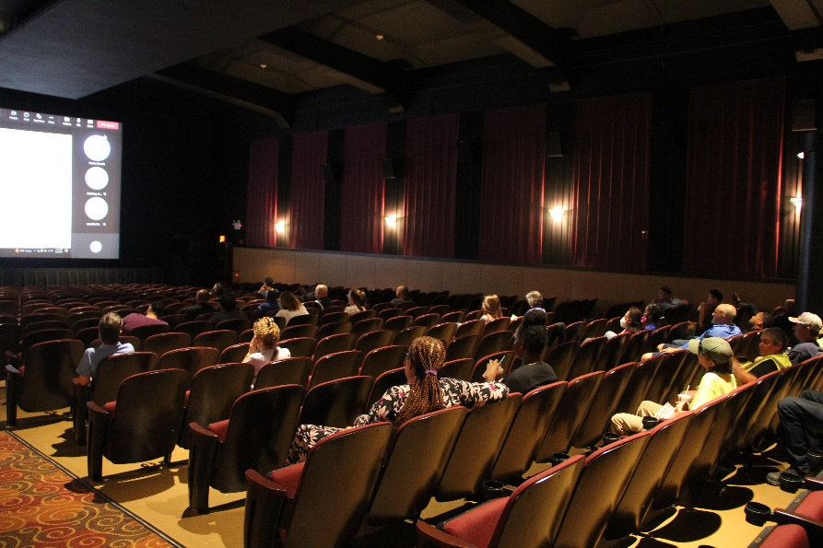
FY2023-Q1 Accomplishments July-September 2022:
Human Resources
Assisted in the implementation of Laserfiche to the cloud.
Rolled out the online benefits self-serve service with employee navigator.
Launched the job classification and compensation study, August 2022. Results expected November 2022.
Advertised the City’s first Diversity Equity and Inclusion Officer position.

Slide 5
FY2023-Q1 Accomplishments July-September 2022: Economic Development
Onboarded a new Economic Development Intern.
Revamped and increased the distribution frequency of the Business Brief Bulletin. Moved to ConstantContact to improve content quality and visibility.
Helped launch the Prince George’s County Economic Development Cooperative, which is a partnership with municipalities and Prince George’s County Economic Development Corporation (EDC) to share information and resources about economic development
Conducted engagement sessions with six (6) businesses to assess business needs and share resources for assistance
Collaborated with Greenbelt CARES to coordinate the Fall Job Fair, which had eleven (11) employers and nearly sixty (60) job seekers participating in the event
Planning underway for ARPA business assistance programming
Planning to bring back the Business Coffee meetings

Slide 6
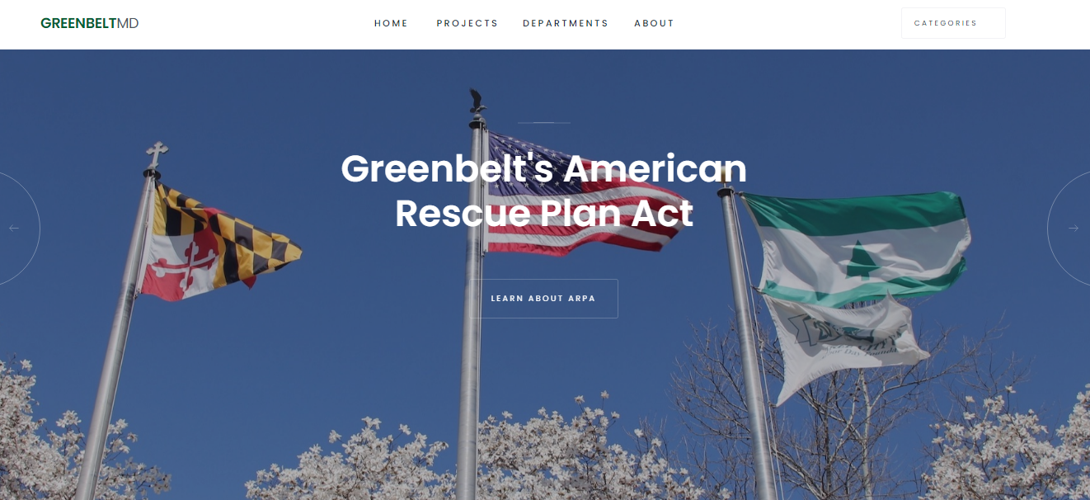
FY2023-Q1 Accomplishments July-September 2022:
Public Information Office
Completed the City of Greenbelt Communications Standards guide
Added a new TV to the Council chambers
Redesigned an interactive ARPA “dashboard” website for project tracking
Purchased a teleprompter kit to expand our videography capabilities.

Slide 7
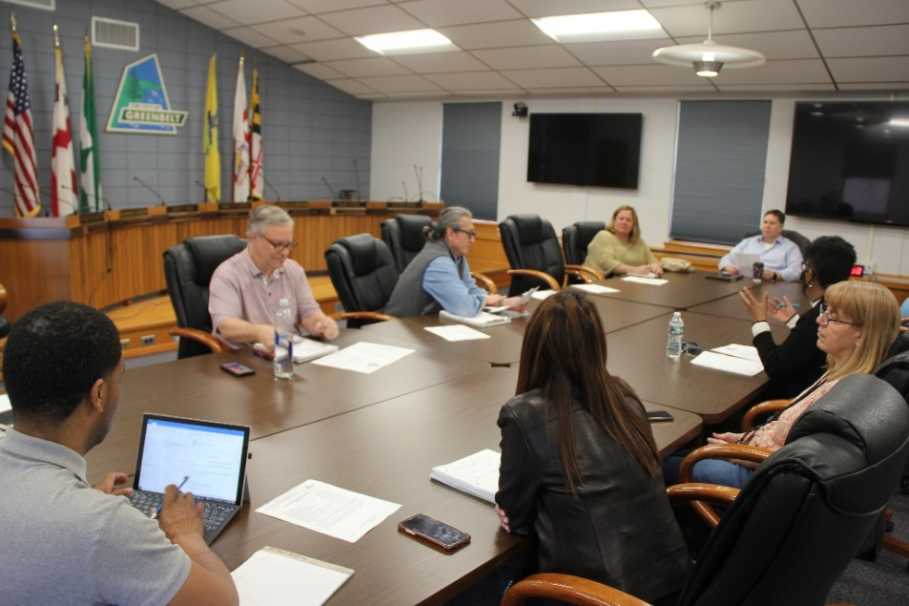
FY2023-Q1 Accomplishments July-September 2022:
Finance
Continuously met with Hagerty consulting group and US Treasury regarding ARPA funding and reporting.
Compiled and prepared a cost recovery report for the July storm.
Completed quarterly ARPA filings
Continuing to work with the contractor implementing the new Financial Management System

Slide 8
FY2023-Q1 Accomplishments: July-September 2022
Information Technology
Network assessment completed by CyberCX
New departmental printers deployed to eliminate a security vulnerability
Prepared GFE space for GAIL occupancy
Requested pricing quotes and preparing RFP’s for various ARPA projects
Interviews for new Security position
Annual computer purchase for replacement units
Ordered security cameras for several City facilities

Slide 9
FY2023-Q1 Accomplishments July-September 2022:
Planning & Community Development
Finalized details for the installation of solar lights at three bus shelters with Public Works. The infrastructure to support the lights has been installed and the lights are anticipated to be installed in the next few weeks.
Work to convert North Center and South Center Drive to one-way is scheduled to begin on October 24th.
Oversaw the implementation of the Temporary Speed Bump Program.
Managed Buddy Attick Park Parking Lot Improvement project through to substantial completion.
Community Development Inspectors conducted 231 residential inspections, 44 commercial and investigated 92 property maintenance complaints.

Slide 10
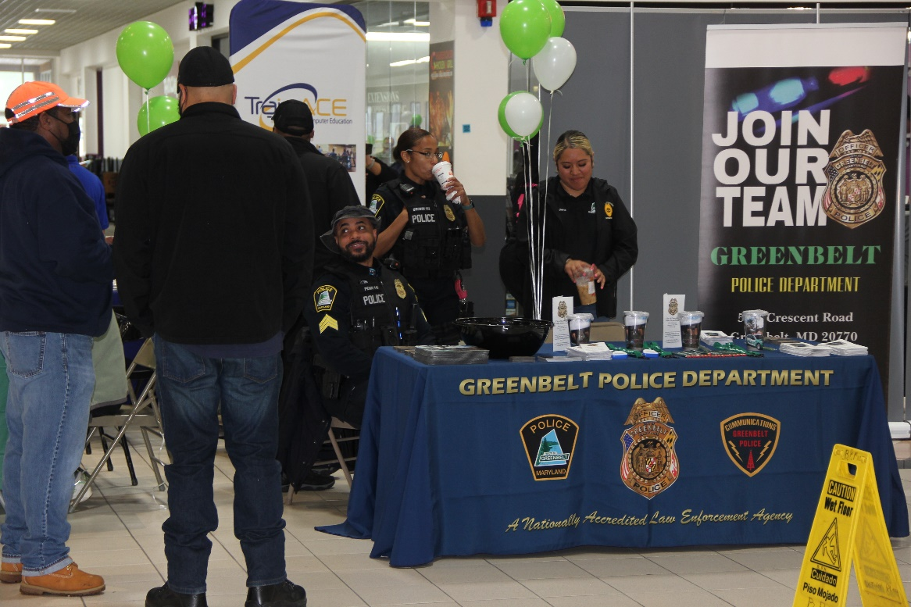
FY2023-Q1 Accomplishments: July-September 2022
Police Department
Completed yearly CALEA file review
Two officers graduated from the Police Academy
Expansion of the Crisis Intervention Team (CIT) program
Participated in National Night Out festivities
Added 4 new officers
Ordered electric bikes
Purchased new cars

Slide 11
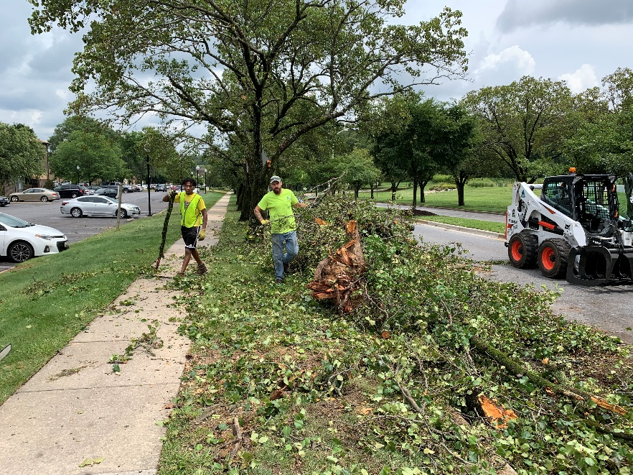
FY2023-Q1 Accomplishments: July-September 2022
Department of Public Works
Admin - Completed the Police Station roof rehabilitation project
Environmental Coor. - Managed the SHL food forest clean-up event for National Public Lands Day
Sustainability Coor. - Managed the first annual EV event at Schrom Hill
Housekeeping - Managed the carpet installation in the Planning Department
Facilities - Installed the solar panel stop light
Carpentry Crew - Rebuilt Animal Shelter handicap ramp and deck
Parks - Prepared turf for the winter months
Horticulture - Planted Fall annuals and bulbs in all City gardens
Mechanic Shop - Performed major rehabilitation to the Loader and Street Sweeper

Slide 12
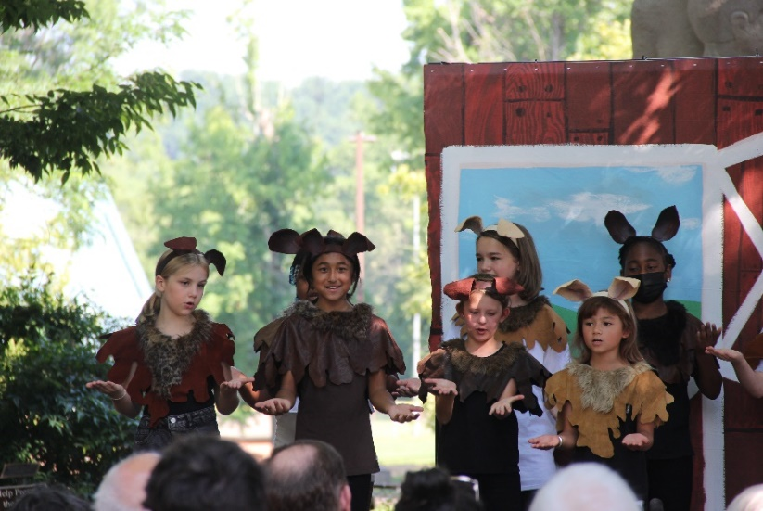
FY2023-Q1 Accomplishments July-September 2022:
Recreation
Youth swim classes, Aqua Mania (adult water exercise class), and Senior Swim returned in the summer.
Adult swim lessons, other water exercise classes (Aqua Fitness and Deep Water Aerobics), and an additional day of Senior Swim were added to our offerings in the fall.
The GAFC also continues to offer First-Aid/CPR/AED and lifeguard training courses
Senior Citizen activities have returned this Fall:
Greenbelt Recreation senior classes
Prince George’s Community College SAGE
Holy Cross senior exercise program,
Weekly meetings of the Golden Age Club

Slide 13
FY2023-Q1 Accomplishments: July-September 2022
CARES
Job Fair at Beltway Plaza on October 8, 2022. A variety of vendors were present including: Greenbelt GPD; Job Corps; Employ Prince Georges; Train Ace; Civility Management; CCI Health; ANGARAI; Prince Georges County Department of Corrections; and Visiting Angels. Over 50 people attended the Job Fair ranging in age from 17-71.
CARES has dispersed $1,750,000 in ARPA Rental and Utility Assistance to 358 households and $53,000 in Mortgage and HOA Assistance to 15 households.
In addition, $82,000 has been dispersed to local food pantries and for City food distributions events.
CARES and GAIL Staff attended National Night Out and spoke to residents about CARES services and upcoming events.
GAIL Program hosted the Back-to-School Mini Health Fair at Springhill Lake Recreation. 125 Greenbelt students received book bags and school supplies. Vendors included Camp Fire, Greenbelt CARES, Lions Club, Community Clinic and more.
GAIL Program hosted Flu Clinics at Greenridge House, the Greenbelt Community Center, the Springhill Lake Recreation Center. Over 300 people were served.

Slide 14
FY2023-Q1 Accomplishments: July-September 2022
Museum
Director, along with FOGM, completed work with a fundraising consultant resulting in a comprehensive capital campaign plan and fundraising materials for the 10A project.
Museum staff and volunteers ran a successful in-person Retro Town Fair with over 85 people attending.
Director presented a lecture at the Reston Museum on Greenbelt history as part of a program about planned communities.
Interest in walking tours is increasing. Staff has recently led tours for the German Historical Institute, a University of Maryland class studying race and public policy, a garden city scholar from Australia, and a representative from the Living New Deal Project.
Director is piloting a new Halloween activity, which includes expanded Halloween decorations at the a museum house, as well as additional historical information about Halloween in Greenbelt.

Slide 15
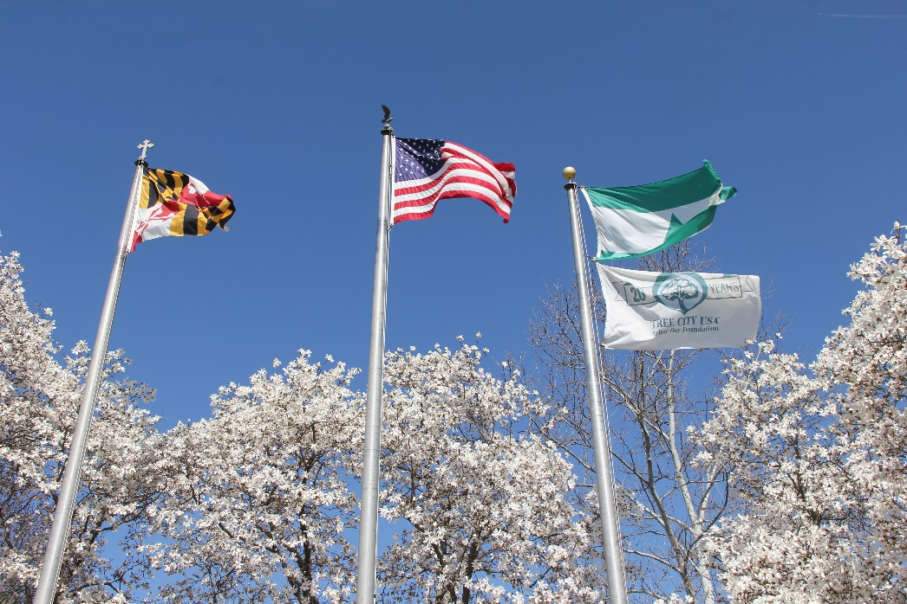
FY2023-Q1 Accomplishments July-September 2022: City Administration
Led the effort to finalize the ARPA Spending Plan
Revised the Economic Development webpages launched in September 2022
Submitted a USDA Compost and Food Waste Grant with DPW
Submitted a DNR Community Park & Playground Grant to replace the playground equipment at the Springhill Lake Recreation Center
Hired the Economic Development Manager and Intern
Hired the Grant Coordinator

Slide 16
FY2023-Q1 Accomplishments July-September 2022:
ARPA
Helped 61 residents with $451,200 in rental assistance (this quarter)
Hired CIC staff for CARES and the Police Department
Helped 4 residents with $15,700 in mortgage/HOA assistance
Processed COVID Premium pay to active, retired, and resigned employees
Finished the ARPA work sessions and achieved Council approval on 35 projects – in addition to the 23 projects in the FY23 budget
Finalizing programs for:
College/Tech School Scholarships
First-time Home Buyer Down Payment Assistance
Healthcare Vouchers
Childcare Vouchers
Developed standard RFP language to meet ARPA guidelines

Slide 17
ARPA: Activities to Date
POTENTIAL SPENDING PROJECTS | LEAD DEPARTMENT | APPROVED ALLOCATION |  | ACTION TAKEN TO DATE
Higher education support/scholarships (including college/trade school/vocational school) | Admin | $500,000 |  | Developing an application and selection criteria. Anticipated to go live in January.
Down payment assistance for new homeowners | Admin | $500,000 |  | Working the MD DHCD to implement through their mechanism
Healthcare vouchers for low-income families | CARES/ Admin | $500,000 |  | Working existing Greenbelt providers to implement through their mechanisms
Recreation Centers - Youth Gym AHU (BCR) | DPW | $70,000 |  | Multiple proposals received
Community Center - Chillers (BCR) & Boilers (BCR) Replacement | DPW | $855,000 |  | Multiple proposals received
Improve network security - cybersecurity threats | IT | $185,000 |  | Firewall price quote requested
Parks 1 1/2 Ton Dump Truck (RF) | DPW | $72,000 |  | Waiting for final proposals
Parks Ford Custom Cab (RF) | DPW | $71,400 |  | Waiting for final proposals
Parks Deep Tine Aerator (RF) | DPW | $22,500 |  | Waiting for final proposals
Police cars (budget) | Police | $725,931 |  | Approved by Council, 10/24/2022
Police Station (BCR) | Police | $405,000 |  | Roof replacement underway.
Streets (CP) | DPW | $900,000 |  | Street resurfacing
Misc Cont (CP) | DPW | $100,000 |  | Sidewalks
Buddy Attick Inclusive Playground (CP) | DPW | $250,000 |  | Multiple proposals received
Municipal Building - HVAC (BCR) | DPW | $131,000 |  | Multiple proposals received
Admin - EV-SUV (RF) | DPW | $45,000
DPW Fuel Managemen System (RF) | DPW | $22,000 |  | Equipment in manufacturing.
DPW Roll Back Truck (RF) | DPW | $75,000 |  | Waiting for final proposal.
DPW Dump Truck (RF) | DPW | $75,600 |  | Waiting for final proposal.
GAFC Pool Room Remediation | DPW | $500,000 |  | Working w/ engineer on RFP docs.
Electric bus for Recreation & Public Works | DPW | $75,000 |  | BAFO received.
Design & Install HVAC upgrades @ YC, CC - Lower Level, & GAFC - Ductwork | DPW | $850,000 |  | Proposals received.
Build fiber connections among City buildings to replace the County Institutional Network (INET) | IT | $250,000 |  | Developing RFP
Expand WIFI within City buildings | IT | $10,000 |  | Price quote requested
City-wide broadband feasibility study | IT | $80,000 |  | RFP near completion

Slide 18
Personnel: Open Positions
Admin
Diversity, Equity, Inclusion Coordinator Reviewing Applications
City Manager Application Under Development
IT
IT Security Specialist Conducting Interviews
Planning
Asst. Dir. Community Development Reviewing Applications
Planner 2 – two positions open* Conducting Interviews
Community Development Inspector Conducting Interviews
Police
Police Officers (3) Actively recruiting
Deputy Chief TBD
Lieutenant TBD
Public Works
Horticulture Supervisor Reviewing Applications
Electrician Reviewing Applications
Recreation
Therapeutic Recreation Supervisor Reviewing Applications

Slide 19
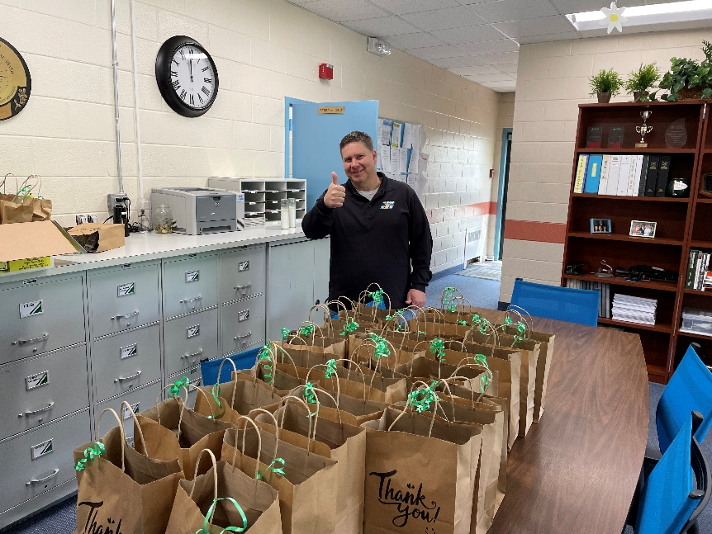
Personnel: Retirements
Pending & Horizon
Pending
Police 1
Public Works 2
On the Horizon
30 years – Now 6
25 years – 2023-2027 5
20 Years 13

Slide 20
FY2023 Challenges
& Opportunities
Providing adequate space for program enhancement and expansion (CARES and Recreation
Providing adequate space for staff (Admin, CARES, IT, Planning, and Police)
Retaining and rewarding current staff
Attracting and recruiting new staff
Newly approved positions
Filling vacancies
Anticipated/potential retirements
Assessment, rehab and reprogramming of the Armory site
Implementing the 58 approved ARPA projects by the Dec 2024 deadline

Slide 21
Questions and Discussion

