Slide 1
PRINCE GEORGE'S COUNTY FIRE/EMS DEPARTMENT
Report Card
City of Greenbelt – Co. 835
FY 2024
Notes:
4/4/2024

Slide 2
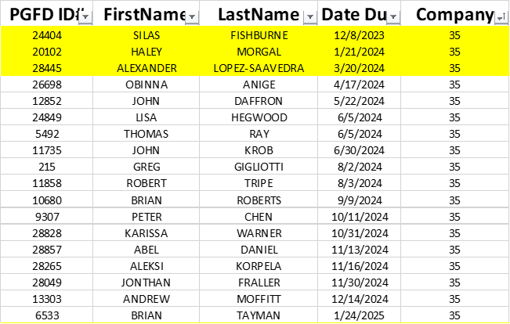
Co. 835 – Greenbelt
Current Fit Tested Volunteer Members as of 4/1/2024
Current Operational Volunteer Members as of 4/1/2024
Current Operational Career Members assigned to Station 835
1 Captain
3 Lieutenants
1 Fire Technician
19 Firefighter/EMT’s
Total: 24 Total Career Personnel – 24 / 7
Career Members work a 24/7
6 Personnel per day
4 Suppression
2 Paramedic Ambulance 835

Slide 4
Overview of Volunteer-Owned / County-Maintained Vehicles
2 Engines – GVFD-Owned / Maintained/Fueled/Insured by PGFD
2 Ambulance – GVFD-Owned & Fueled by other sources
The two Engines & Support Units are fueled and maintained by Prince George's County.
$14,450.34 Total Fuel spent – FY 2024 for two (2) Engines
$14,500.00 Approx – Insurance Payments – FY 2024 for two (2) Engines

Slide 5
Budget for Co. 835 – FY’24
Small Tools
BUDGET: $4,000.00 / Year
SPENT: $4370.65 ($ 370.65) – 109%
Stores
$4,000.00 / Year
SPENT: $2804.44 – 70%
Uniform (Volunteers Only)
$2040.00 - ($120.00 X Fit Tested Members – July 2023)
SPENT: $46.93 – 2%
Station Program Funds
Up to $40,000.00 – Per Year.
Station 835 has been identified as a fire station staffed 24/7 by Career Staffing – a station where career staffing is the primary service provider.
15,000.00 Annually: 24/7 Career Staffed Station either county-owned or volunteer-owned with minimum staffing from a fire station.

Slide 6
Call Volume Co. 835
1/1/2022 – 12/31/2022
Total Calls: 4962 – CY 2022
Career Staffed Apparatus
4,778 Calls
Volunteer Staffed Apparatus
184 Calls

Slide 7
Call Volume Co. 835
1/1/2023 – 12/31/2023
Total Calls: 4941 – CY 2023
Career Staffed Apparatus
4,817 Calls
Volunteer Staffed Apparatus
124 Calls

Slide 8
Call Volume Co. 835
1/1/2024 – YTD
Total Calls: 1272 – YTD 2024
Career Staffed Apparatus
1,235 Calls
Volunteer Staffed Apparatus
37 Calls

