Slide 1
July 31, 2024
GREENBELTMD
Quarterly Review & Progress Update
Q4 FY2024

Slide 2
City Manager – Overview
Progress & Strategic Advancements:
Strategic Meetings with Department Heads
Review of City's policies, procedures, and structure for planning in FY2025
Comprehensive review of Records Retention Policies and Schedules.
Recodification of City Code- 18 month project.
Comprehensive Review of Programs and Services, Organizational Capacity and Resources
Preparation of the FY2025 Budget
Closed a $3 million deficit while continuing to deliver exceptional services to you, our residents.
Funding two Crisis Intervention positions and a constituent services to assist residents connect with resources offered by the City, County, and State. These positions are vital in addressing trauma and crisis within our community, aligning with the Council's vision and mission.
Communication & Collaboration:
Reaching a broader audience and engaging more constituents through various communication channels. With a total of 1,316 new email subscribers and an impressive 56.49% average open rate,
Strong engagement with constituents, addressing community concerns; Charlestowne North Apartments, Various Property Management issues,
greenbeltmd.gov
7

Slide 3
City Manager – Overview
Prioritization & Development:
FIRE/EMS SERVICES
Ongoing Legal and Operating Issues.
Acquired additional AEDs for municipal buildings and PD vehicles.
ARPA, ARPA, ARPA
Justice, Diversity, Equity and Inclusion Initiative; Released Internal Audit, Launched Action Teams, and Began Phase II of JEDI Audit
Infrastructure Challenges – Repairs to sidewalk, Storm drainage Systems, Playgrounds
Launched Strategic Initiatives and Projects: Space Optimization, EV Infrastructure and Energy, Pepco Street Lights and Economic Development.
FBI Site Development
Received notice of award of a $350,000 bond bill for Greenbelt Cinema renovations
greenbeltmd.gov
7

Slide 4
DEPARTMENT
ACCOMPLISHMENTS

Slide 5
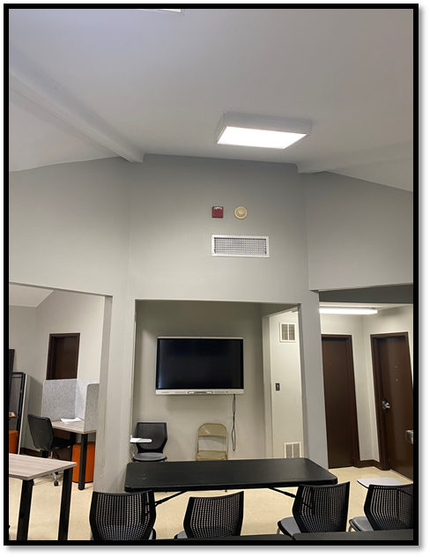
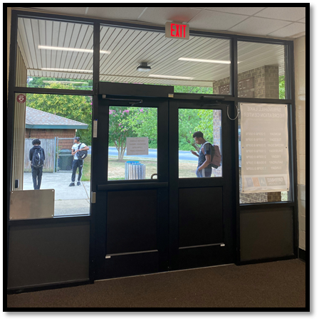
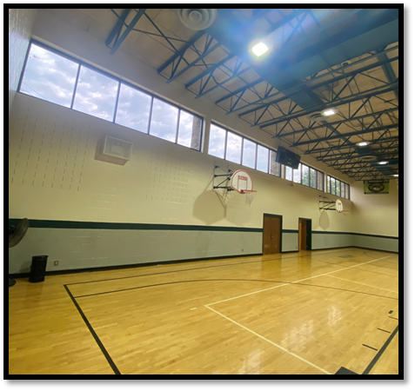
SHLRC updates
Gym New Paint Scheme
Club House Repairs

Slide 6
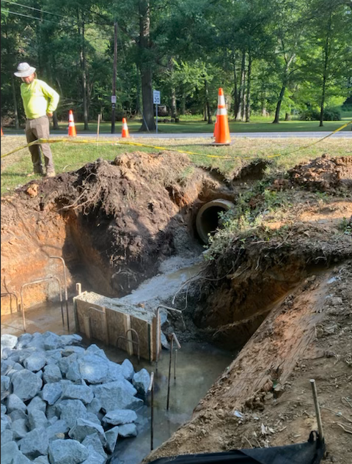
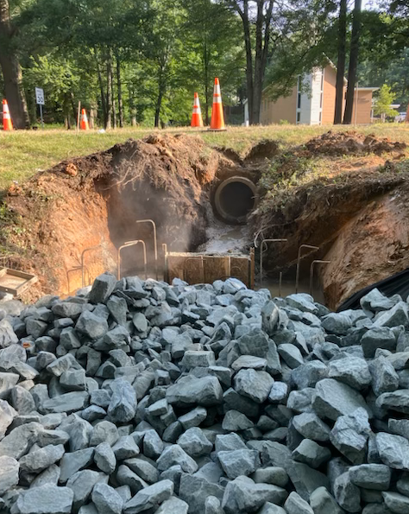
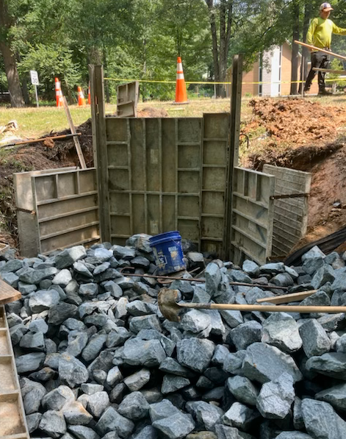
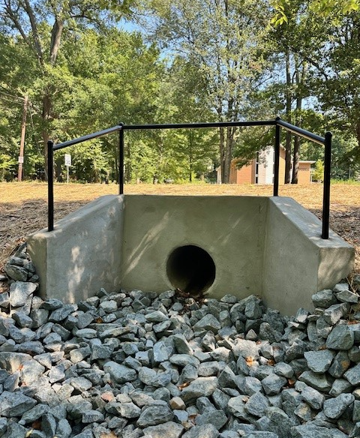
Public Works
ACCOMPLISHMENTS
Concrete Headwall - Pipe Culvert Remediation (Crescent Rd)
greenbeltmd.gov

Slide 7
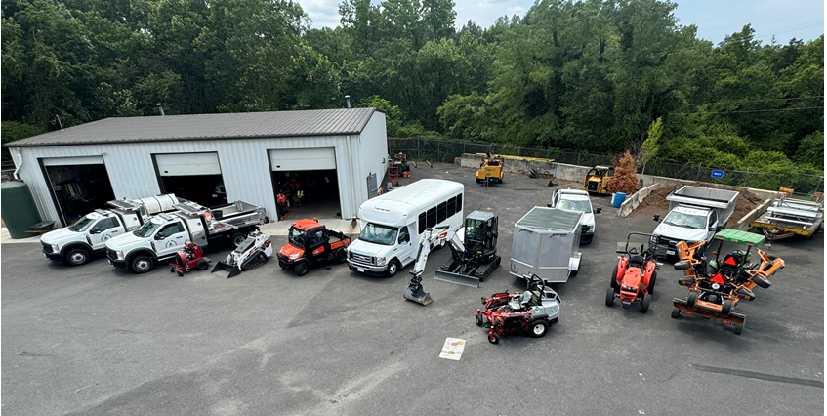
Public Works
ACCOMPLISHMENTS
Acquired Ball Field Maintenance Equip, Vehicle, Bus, etc.
greenbeltmd.gov

Slide 8
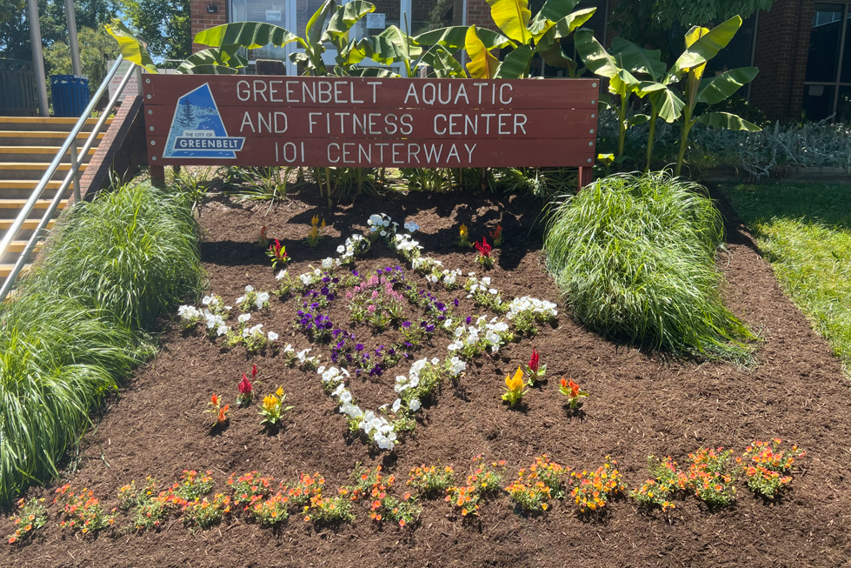
Public Works
ACCOMPLISHMENTS
Installation of New Landscape Design
greenbeltmd.gov

Slide 9
Human Resources
ACCOMPLISHMENTS
Innovating The Onboarding Experience
Launched a self-use electronic PowerPoint for new hires, simplifying the orientation process. Test with 35 new hire, and is now the standard.
Strategic Staffing:
Hired a new Clinical Supervisor – CARES
Hired a new Community Mental Health Counselor – CARES
Hired / Onboarded 78 new camp staff and 5 Summer Help Staff for Public Works.
Operational Enhancements:
Negotiate Health Insurance premiums to not exceed 2% of current rate.
Selected an HRIS vendor/ system
Progressed in policy revision for compliance, annual evaluations, and improved leave benefits to attract and retain talent.
Feedback and Continuous Improvement:
Pending- Develop an electronic exit interview system to gather insights.
greenbeltmd.gov

Slide 10
Finance
ACCOMPLISHMENTS
Completed the FY2025 budget preparation process in time for adoption on or before June 3, 2024. Maintained the salary levels that were established in last year’s Compensation Study.
Submitted the 4th Quarter ARPA Report to Treasury.
Completed the 2023 annual audit and the Annual Comprehensive Financial Report (ACFR) and is now on City’s website.
Submitted the application and supporting material to GFOA for the FY2023 CAFR award. Awaiting decision.
Set up new federal account required for the City to receive energy rebate from the electric vehicle purchases during the year.
greenbeltmd.gov

Slide 11
Public Information Office
ACCOMPLISHMENTS
Coordinated Buddy Attick Park feature interview with Experience Prince George’s and WUSA TV.
Participated in a live interview with WPGC host Poet “Poe” Taylor for the American Red Cross Blood Drive.
Coordinated the NLC 100th Anniversary Roadshow visit to the City of Greenbelt.
Coordinated the 1st quarterly Hotel Roundtable Discussion with President/CEO Leslie Graves of Experience Prince George’s.
Completed onboarding for CisionONE News Monitoring Service for Print/Online/Magazine.
Facilitated the City of Greenbelt Ad placement in the Fall/Winter 2024 and Spring/Summer 2025 Experience Prince George’s Visitors Guide. The guide highlights Prince George’s as a vibrant tourism destination.Annually, 25,000 copies are distributed, and the digital edition garners over 350,000 views.
Facilitated the coordination of city staff at careers fairs/days at Roosevelt High School, Greenbelt Middle School, and Springhill Lake Elementary School
greenbeltmd.gov

Slide 12
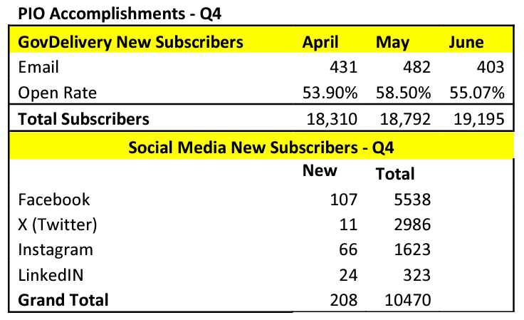
Public Information Office
ACCOMPLISHMENTS
greenbeltmd.gov

Slide 13
Economic Development
ACCOMPLISHMENTS
Posted an RFP for the Economic Development Marketing Plan
Posted the Economic Development Manager position and reviewed resumes. Currently conducting interviews
Hosted a Business Roundtable for the City’s Hoteliers
Organized a Job Fair with CARES, attracting 80+ attendees
Attended the MEDA annual conference, engaging with peers while promoting Greenbelt
Provided Seed funding for Greenbelt’s Jobs and Workforce Center, and Entrepreneur Lab, at Beltway Plaza. Will host Ribbon Cutting in August.
greenbeltmd.gov

Slide 14
Planning and Community Development
ACCOMPLISHMENTS
Oversaw erosion and sediment control inspections and right-of-way construction at the new Royal Farms site.
Managed to review of a Special Exception application for LOL Child Care Center at Beltway Plaza.
Managed the procurement of parcel 84, a 22-acre undeveloped parcel located adjacent to the Greenbelt Station Development and State-owned preservation land.
Successfully applied for the renewal of the City’s designation as a Maryland Sustainable Community.
Prepared and submitted two grant applications. One for 90% engineering of the Hanover Parkway off road bicycle facility and one for the preparation of a Vision Zero plan an associated demonstration projects.
Managed the review of the WSSC standpipe rehabilitation project and T-Mobile’s request to install a temporary 110-foot monopole at 211 Ridge Road to allow continuous cell service during WSSCs project.
Reviewed and prepared comments on the Bureau of Engraving’s Supplemental Environmental Assessment.
Received City Council approval of ARPA funded bus stop safety and accessibility projects.
greenbeltmd.gov
Notes:
In addition to: WMATA Connection Trail Project:
Received NPDES permit approval and consulting with WMATA post-FBI relocation announcement.
Trail project's procurement documents on hold pending impact assessment.
ARPA Projects for Pedestrian/Bicycle/Bus Safety:
Collaboration with Public Works for ARPA project implementation.
Traffic Calming Study initiated, and bus safety project plan in development.
Wayfinding Signage Project Management:
Working with the County and consultants on wayfinding research, destination identification, and community engagement.
SHA Greenbelt Road Corridor Planning:
Awaiting grant award notification from the Reconnecting Communities program.
Community Development Enhancements:
Reviewing software proposals for field portability and efficiency.
Achieved a 50% inspection rate at Franklin Park.
Progressing towards online payment and application capabilities.
Developing strategies for short-term rental licensing compliance.
Accomplishments:
Promoted Gilberto Cabrera as Assistant Director of Community Development.
Maintained erosion and sediment control enforcement authority.
Approved ARPA spending for Pedestrian and Bicycle Improvement projects.

Slide 15
Police Department
ACCOMPLISHMENTS
The department hosted multiple community functions.
a) Wellness Walk at Buddy Attick Lake
b) Community Walk in Greenbelt Station.
c) Summer Youth Program
d) Citizens Police Academy
The department responded to a large-scale shooting incident at Schrom Hills Park. This incident resulted in five individuals suffering injuries. Through the investigation, the department identified two suspects who were criminally charged.
The department continues to enhance the Crisis Response Team. The department has trained two officers who remain assigned to patrol to provide crisis when the full-time team is not available.
The Criminal Investigations unit investigated four contact shooting incidents over four weeks in April. Each case was closed, with the defendants being identified and criminally charged.
greenbeltmd.gov

Slide 16
Recreation
ACCOMPLISHMENTS
The Community Center gym floor refinishing project was completed. Two pickleball courts were added. The City now has 8 outdoor and 4 indoor courts.
Google Translate Program - Training for all recreation facility staff was completed in May. IT has ordered two new Wireless Access Points to enhance the Wi-Fi Connectivity in the Community Center and Greenbelt Aquatic Fitness Center lobbies. IT staff will coordinate with Public Works staff to install the new Access Points. Once the Wi-Fi enhancement is complete, we plan to install locked tablet stands in recreation facilities to secure the tablets and make them available to the public. Public Works will soon mount a new large screen tv in the GAFC entry atrium, which will display written announcements in English and Spanish. The tv will provide information on pool hours, rules, appropriate attire and other topics often covered by staff and will significantly reduce the wait time for pool entry during the busy summer season. Tablets are now available in all city recreation facilities. Once the Wi Fi enhancement is complete, we will work with Public Works staff to mount the tablets at the welcome desks of each recreation center.
greenbeltmd.gov

Slide 17
Recreation
ACCOMPLISHMENTS
Shade Structures were installed around the perimeter of Greenbelt Station Central Park.
The Recreation Department began managing City special events and permitting community organization events. Formalization of the permitting process in underway.
Trained ALL summer camp staff in inclusion (not just inclusion staff). Stressed the importance for staff to practice inclusivity for all campers. Inclusion is the responsibility of ALL staff.
Camper Intake Form was redesigned to give staff more detailed information on campers. For campers that need inclusion services, pre-camp meetings were held between staff and families to foster a positive relationship.
greenbeltmd.gov

Slide 18
CARES
ACCOMPLISHMENTS
CARES staff relocating to the first floor of the Municipal Building.
GAIL staff staying in the Community Center Ground Floor East.
Coordinated services with the Police Department for residents in crisis:
Provided clinical supervision to Police CIT counselors.
Followed up with residents referred for mental health and case management.
Held CIT meetings with GAIL team to support senior care.
Enhanced Community Nursing Program with University of Maryland.
Partnered with Luminis Health's mobile wellness vans for the Back-to-School Health Fair.
Delivered case management and information services to Green Ridge House residents:
Linked residents to various programs and services.
Used SASS funding for home-delivered meals and housekeeping aides for at-risk and frail residents.
greenbeltmd.gov

Slide 19
Information Technology
ACCOMPLISHMENTS
Fiber project completed – Fiber is installed and lit on most City buildings
Switch upgrade – Deployed network switches throughout most City buildings
Implemented email MFA for all users
Schrom Hills Comcast connection installed and park cameras brought online
Replaced 7 EOL Meraki WiFi APs
greenbeltmd.gov

Slide 20
Grants
ACCOMPLISHMENTS
Oversaw 33 grant request submissions totaling over $7.4 million.
Received $105,000 in grant funding in FY 2024 Q4, bringing the total amount of funds received for FY 2024 applications to over $1,000,000. This amount is expected to continue to increase as more grant awards are announced.
$105K PGCC CARES Youth Service Bureau 3102
Submitted first-ever federal "earmark" grant requests to Congress in the amount of over $2.4 million.
Worked with Department Directors to update Grant Goals, Policies and Procedures to streamline grant process and increase grant awards.
greenbeltmd.gov

Slide 21
Personnel: Open Positions
List of current vacancies.
Animal Control Shelter Supervisor and Coordinator | Currently Interviewing for Coordinators, already conducted interviews for Supervisor Role |
Human Resource Generalist | Position On Hold while we integrate new HRIS System
Update on recruitment efforts. | We are now utilizing other sources for advertisement such as (Linkedin, Indeed, Social Media (Facebook).
greenbeltmd.gov

Slide 22
QUESTIONS?
greenbeltmd.gov

